Slide 1
Android
Lab 01
2017-2018

Slide 2
Agenda
What is Android?
What tools will be used in Lab?
Hello World Example
What files exist in an android project?
How To access data in files ?
Add Two Numbers Example
On going term application

Slide 3
What is Android?
An open-source software platform used primarily to power mobile phones
Essentially, a unified platform to develop apps that will run on many different phones and devices
Notes:
Is a linux based OS for mobile devices, such as smart-phones and tablet computers
and a platform is something that applications can be built on or run on. A platform serves no direct purpose to end users itself. It does provide infrastructure for one or more applications (which do serve a direct purpose to end users).

Slide 4
What tools will be used in Lab?
Android studio
Code is written in Java
Notes:
ADT: Android Development tools
Android SDK: software development kit

Slide 5
Hello World Example
Creating a New Project
In Android studio :choose File→New→New Project
Next, You need to fill out your project properties.
“My Application“: is the plain English name of your application.
Type ‘HelloWorld’ as a project name
A project name should be one word. (“CamelCase” naming convention is preferred)
“The package name”: for example ‘android.section’
Next, you need to choose the build target.
The build target tells the build tools which version of the Android platform you are building for.
Specify An activity that is going to be represented by a Java class.
Its name should adhere to Java class naming conventions: start with an upper-case letter and use CamelCase to separate words.
So, type ‘HelloWorld’ for your activity name or leave it as ‘ HelloWorldActivity’.
Finally, click on the Finish button, and Android studio will create your project.
Notes:
Activity is like the forms in desktop development
Views is like visual components “controls” in desktop development
Application Name is what will appear in Android Market and when you manage your applications (when app is installed in your mobile)
setting the build target to the latest version allows you to enable new features and optimize your app for a great user experience on the latest devices.
Important: http://developer.android.com/guide/topics/manifest/uses-sdk-element.html

Slide 6
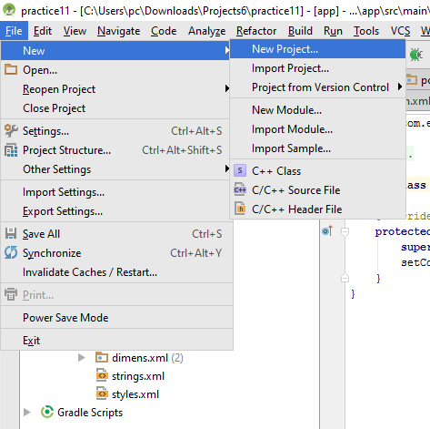
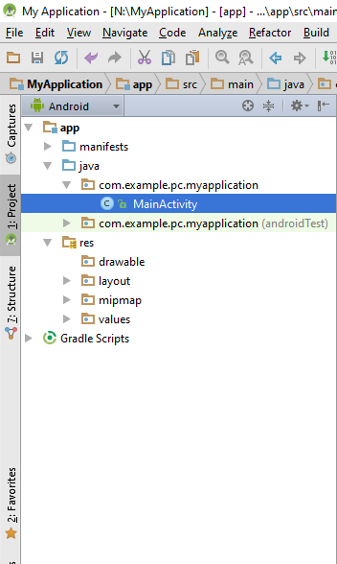
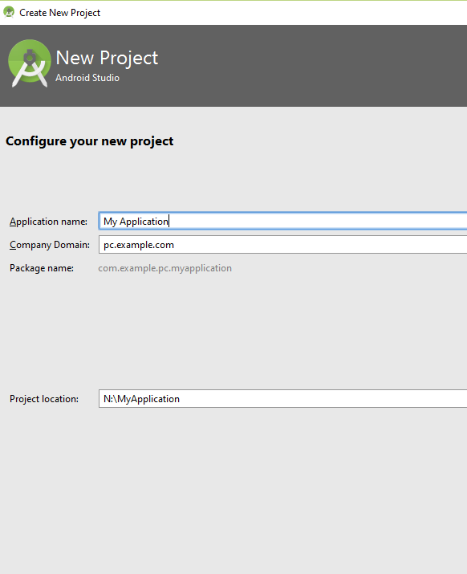
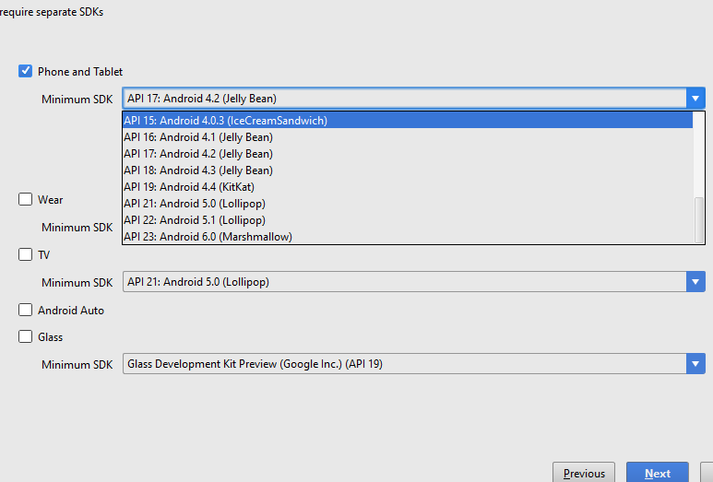
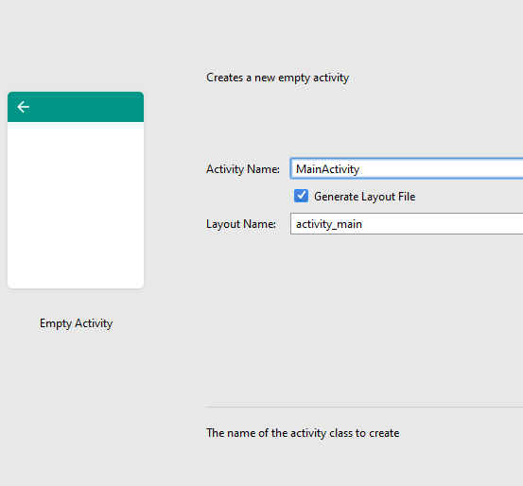
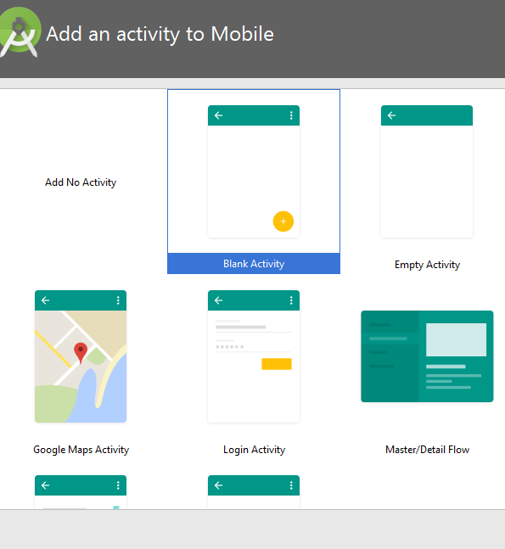
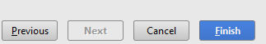
Hello World Example Cont’

Slide 7
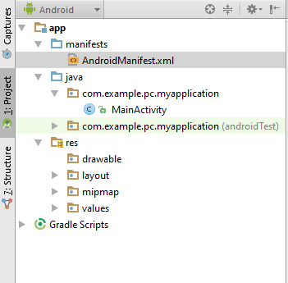
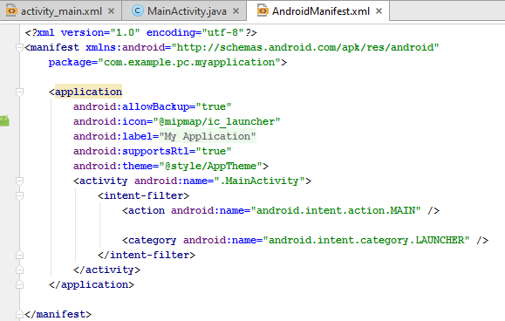
Manifest File
It is this file that explains what the application consists of, what all its main building blocks are, what permissions it requires, and so on
Notes:
The “metadata” about the application and its components.
–Application: Name, icon, version, required Android version
What permissions does this application need?
What features does this application need or use?
android.intent.action.MAIN means that this activity is the entry point of the application, i.e. when you launch the application, this activity is created.
category -- Gives additional information about the action to execute.
CATEGORY_LAUNCHER means it should appear in the Launcher as a top-level application

Slide 8
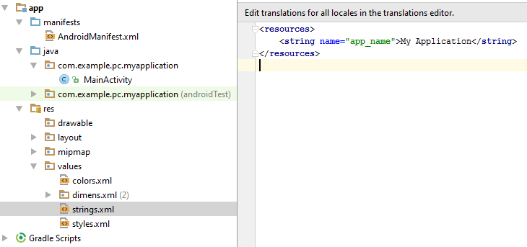
Strings File
This is another XML file that contains all the text that your application uses.
For example, the names of buttons, labels, default text, and similar types of strings go into this file.

Slide 9
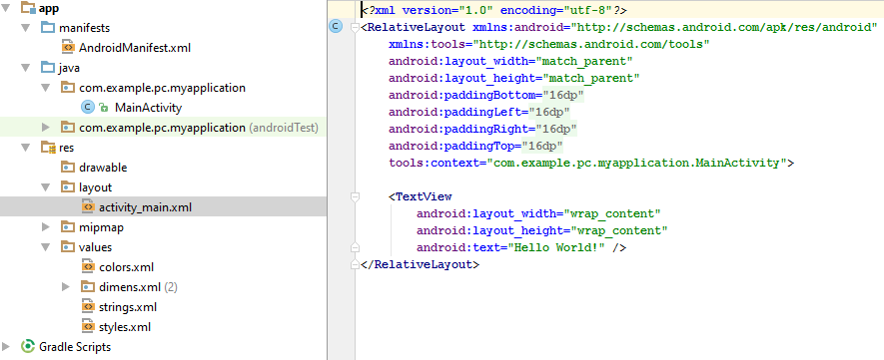
Layout File
The layout file specifies the layout of your screen.
Notes:
LinearLayout: A Layout that arranges its children in a single column or a single row.

Slide 10
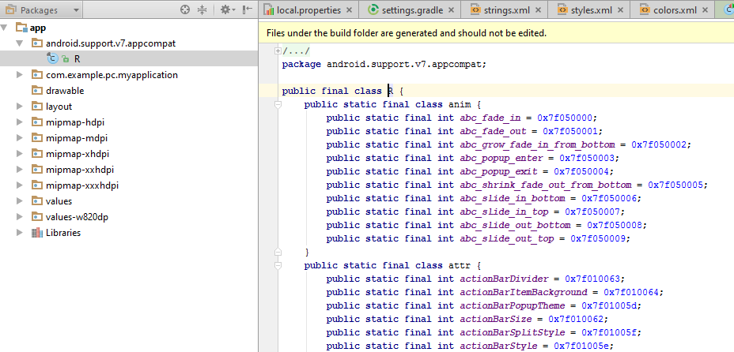
R File
It is an automatically generated file, and as such, you never modify it.
It is recreated every time you change anything.
Notes:
Android R.java is an auto-generated file that contains resource IDs for all the resources of res/ directory.
R.string.hellow -> return the id of the string
R.layout.main -> return the id of the main activity
R.id.btn1 ->return the id of the button

Slide 11
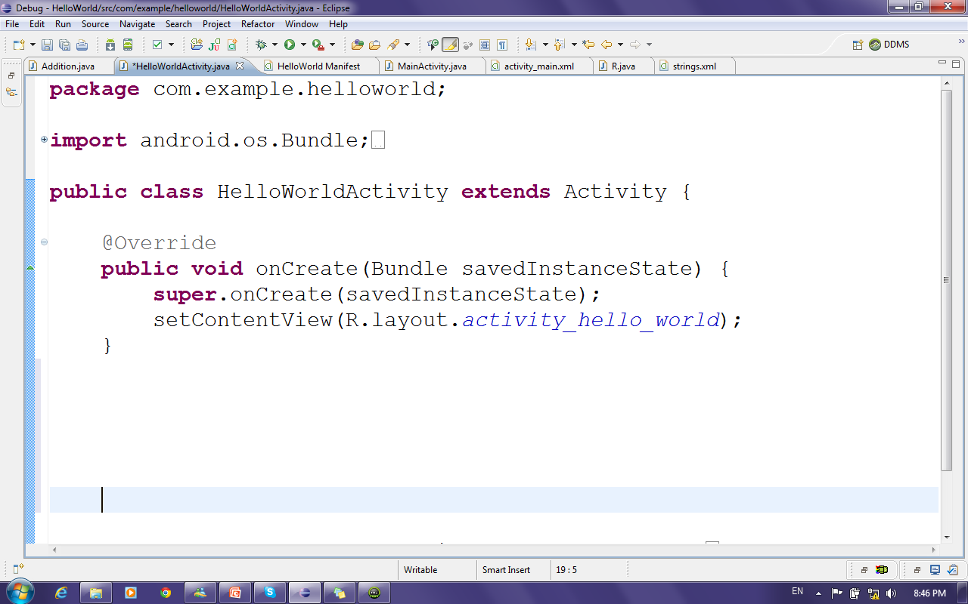
Java Source Code
The Java code is what drives everything.
This is the code that ultimately gets converted and runs your application
Notes:
- The Bundle in the onCreate method should hold the state of you activity before it was killed.
onCreate(Bundle) is where you initialize your activity. Most importantly, here you will usually call setContentView(int) with a layout resource defining your UI, and using findViewById(int) to retrieve the widgets in that UI that you need to interact with programmatically.
If you save the state of the application in a bundle (typically non-persistent, dynamic data in onSaveInstanceState), it can be passed back to onCreate if the activity needs to be recreated (e.g., orientation change) so that you don't lose this prior information.
- onCreate(Bundle savedInstanceState) you will get the Bundle null when activity get starts first time and it will get in use when activity orientation get changed .......

Slide 12
How To access data in files ?
String.xml
Javacode.java
Layout.xml
R.Layout.layoutName
R.String.stringname
String.xml
@string/stringname

Slide 13
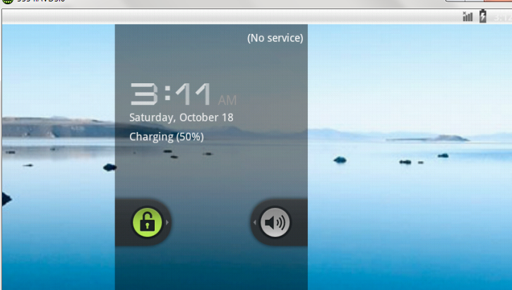
Running Hello World Example
Running the project
First, We will create new Android Virtual Device (AVD)
In Android Studio, Tools →Android →AVD Manager
Specify Device then target then Name
Finally, Finish
Then right click on the project → run MainActivity
Notes:
An Android Virtual Device (AVD) is an emulator configuration that lets you model an actual device by defining hardware and software options to be emulated by the Android Emulator.
Note: Be sure to define a target for your AVD that satisfies your application's Build Target (Note that if the AVD's Android version is lower than the Minimum API level set in the Manifest, the AVD will not appear in the list).
In Eclipse, click on Run in the toolbar then Run Configurations. Select your application and click on the Target tag. You can then select which AVD to use or set it to manual so it asks you each time you run the app.

Slide 14
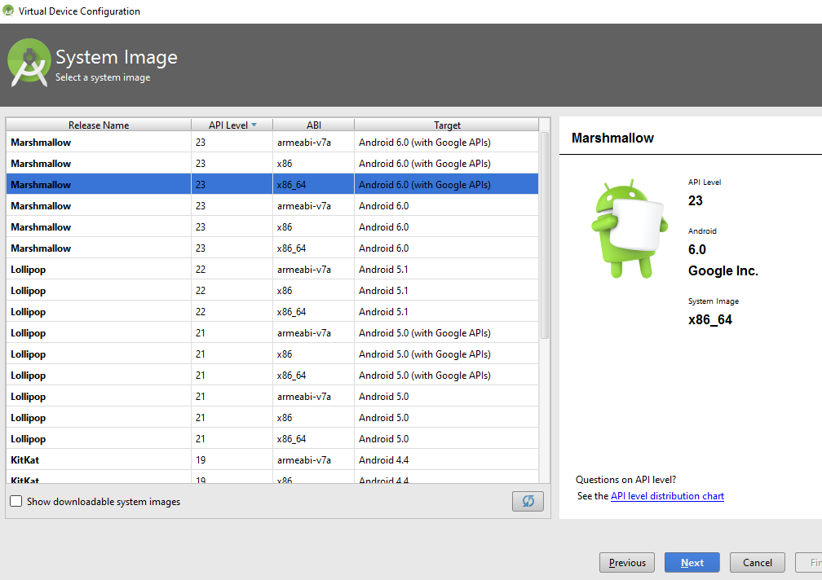
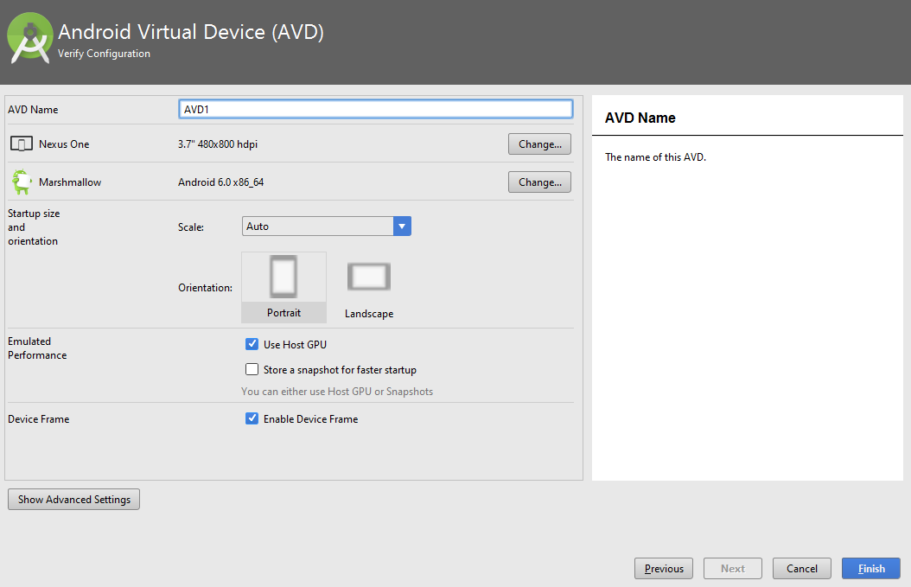
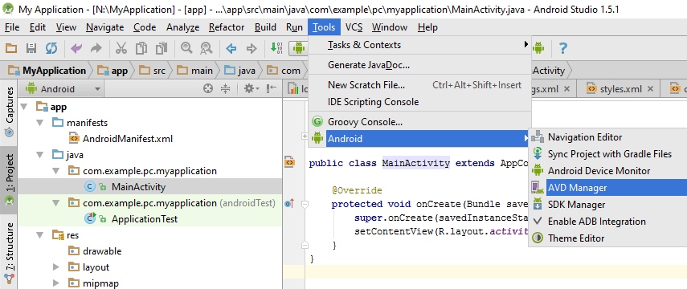
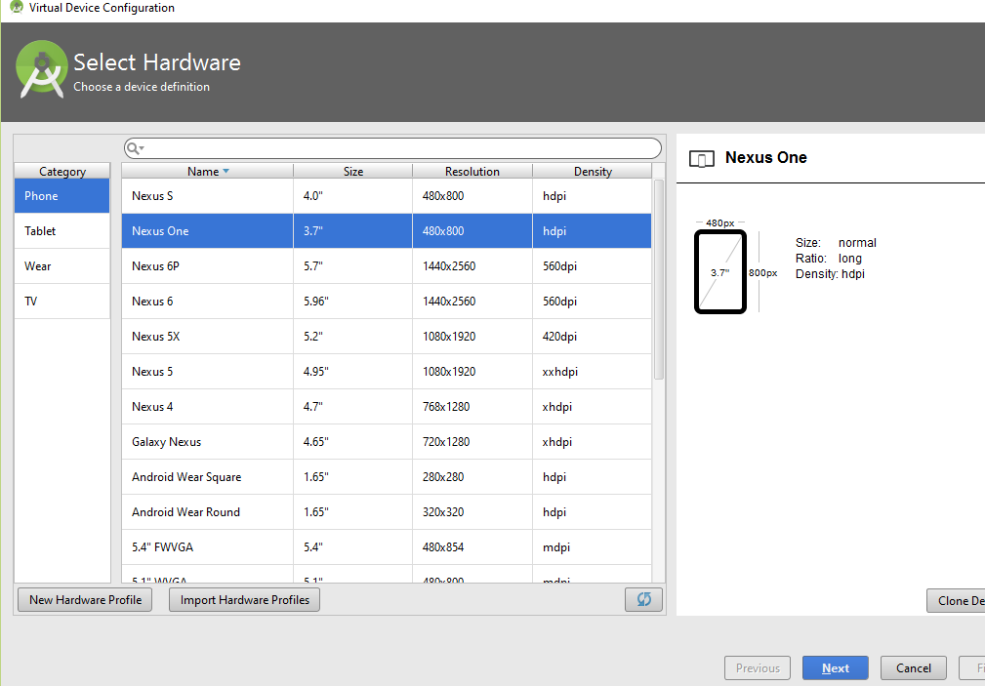
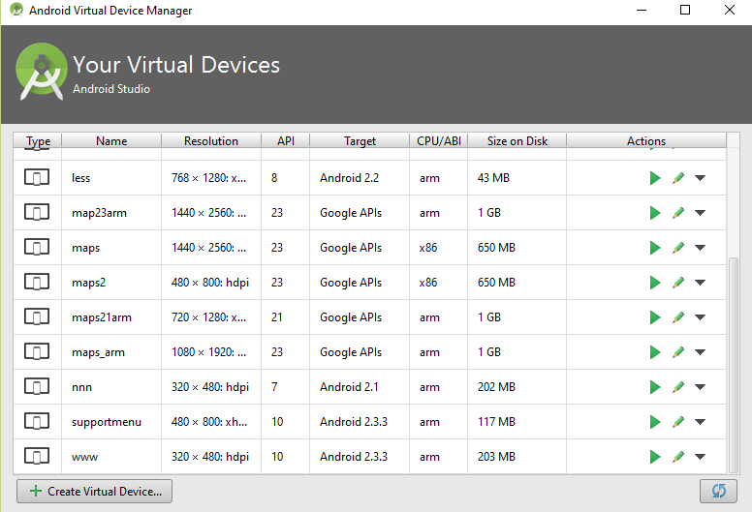
Running Hello World Example Cont’

Slide 15
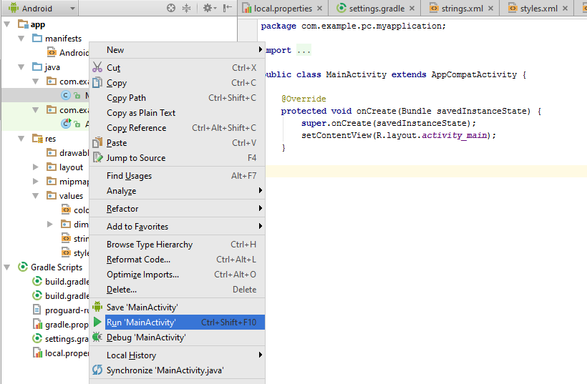
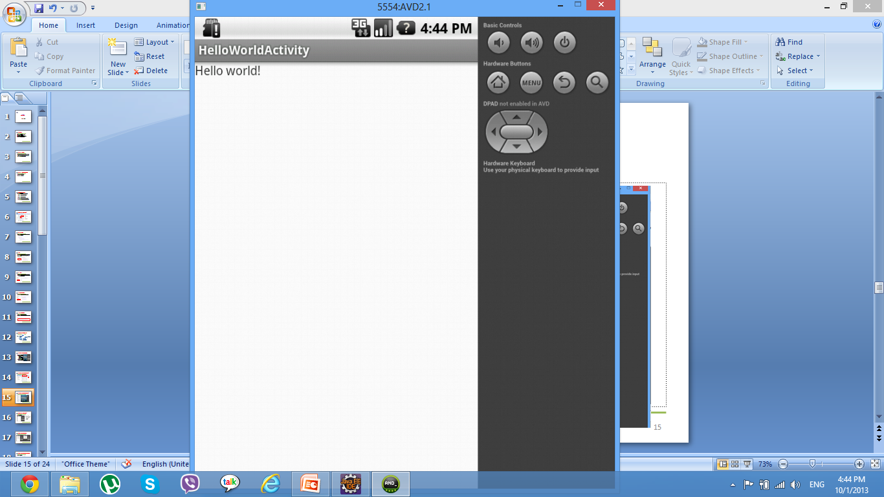
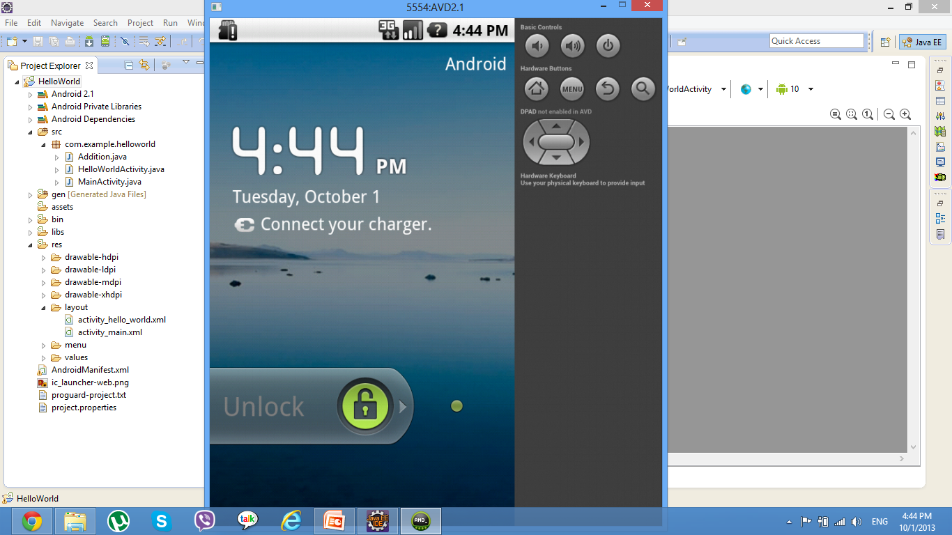
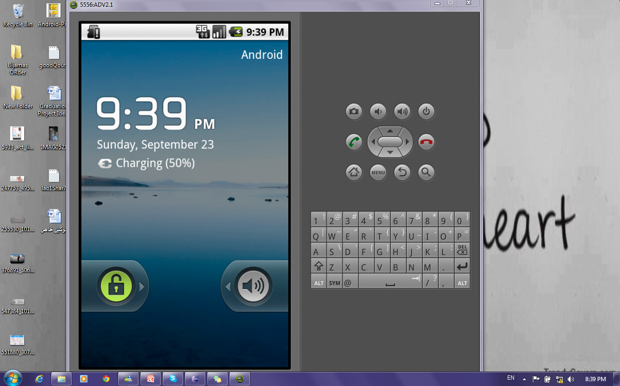
Running Hello World Example Cont’

Slide 16

Hello World Example Cont’
15 Minutes
Create Project.
Create an AVD if it not exist
Run it.

Slide 17
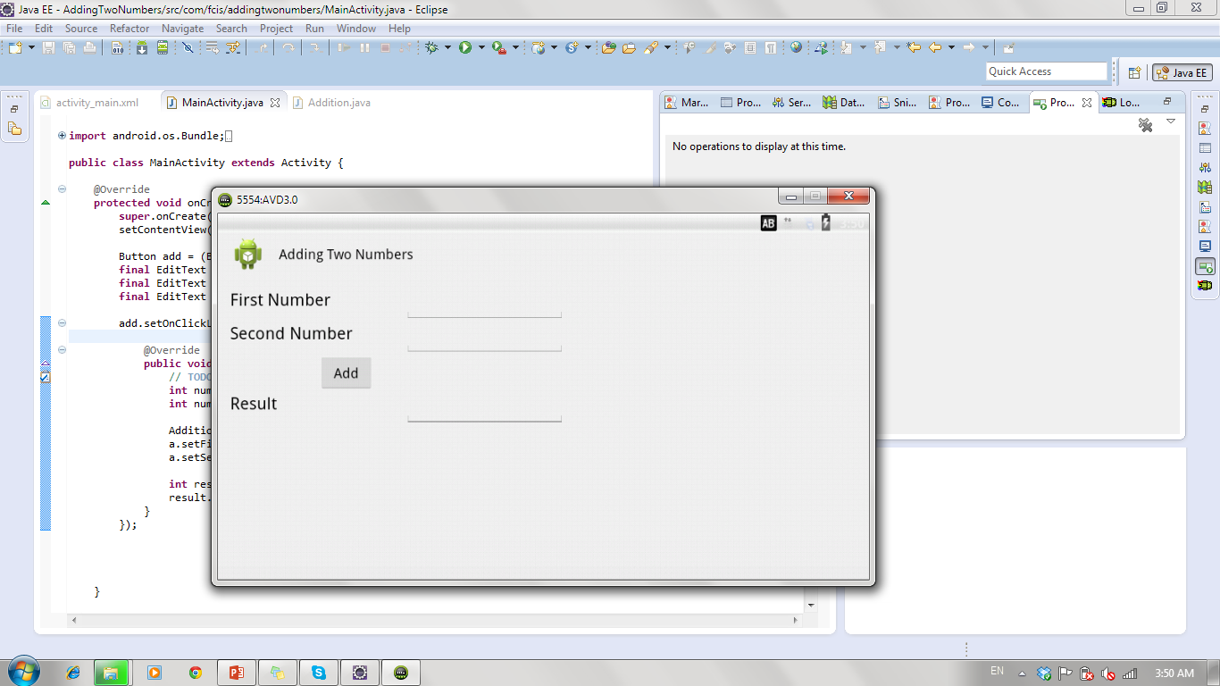
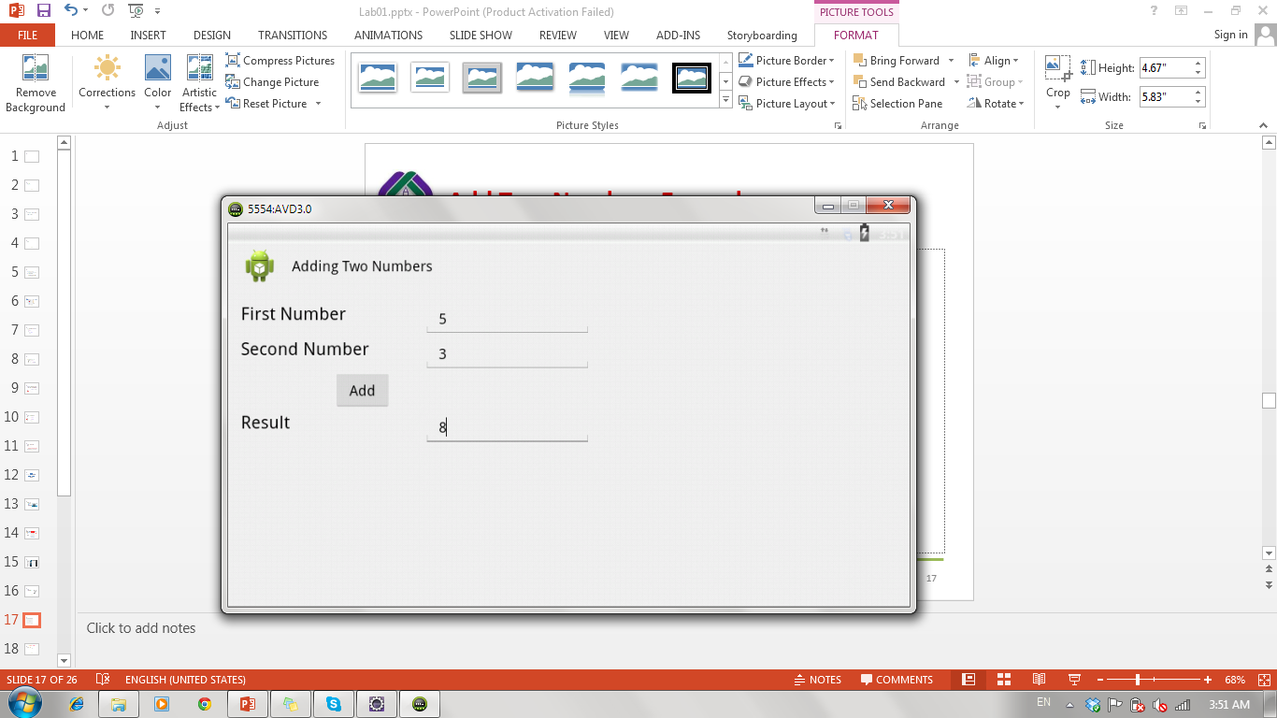
Add Two Numbers Example
Notes:
To change text and id:
Right click on view →Edit id
Right click on view → Edit text → new string → R.String “the name that will be used in code”
→ String that is the value that will be shown
Example: x=“Name” → R.string is x and string is Name

Slide 18
Add Two Numbers Example: What will be changed !!!
Main.xml file → Layout
Main.java file → Code
String.xml file → Texts used in GUI
Note: R file is automatically changed

Slide 19
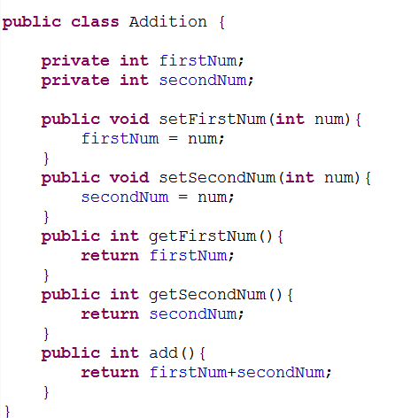
Addition Class

Slide 20
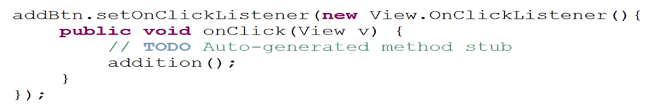
Add Two Numbers Example: How to add action on the button?
First we need to get button id so we can add action listener on it.
findViewById(R.id.btn_add)
Then add actionListener to the button on the main.java in the onCreate Method
Notes:
- You implement an action listener to define what should be done when an user performs certain operation.
onClick(View v) Called when a view has been clicked.

Slide 21
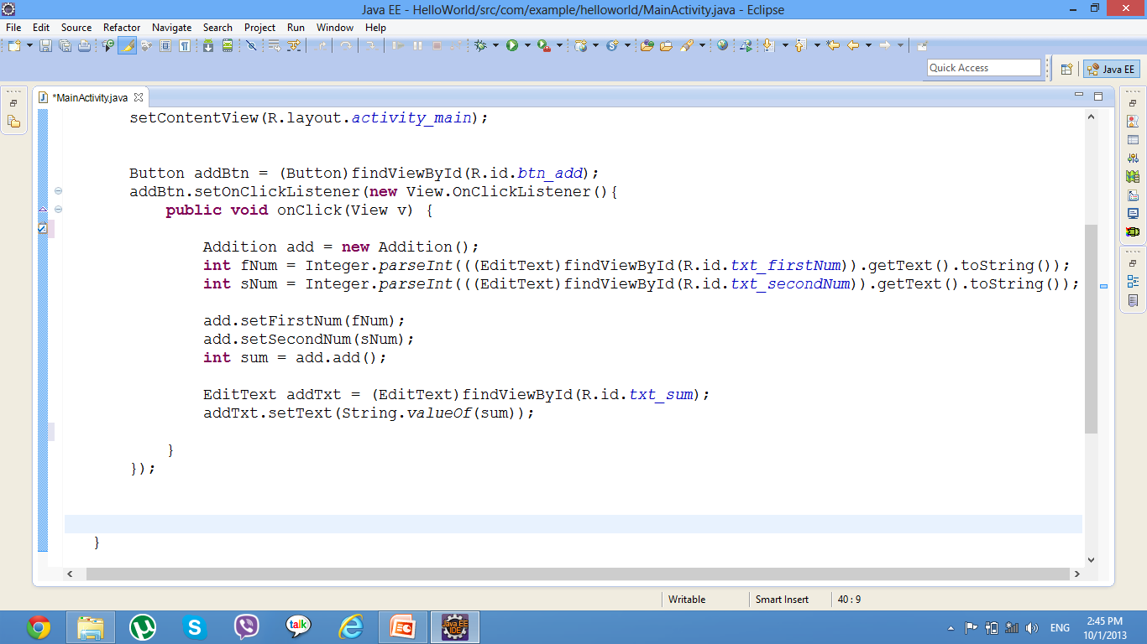
Add Two Numbers Example: implementation
Get FirstNum text through its id from R file
Get number entered by user in edittext

Slide 22
Add Two Numbers Example: Complete and Run
30 Minutes
Create project
Create addition Class
Create required GUI
Complete main.java file.
Run Application and test it.

Slide 23
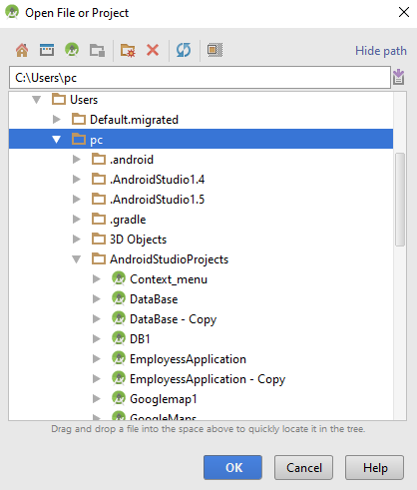
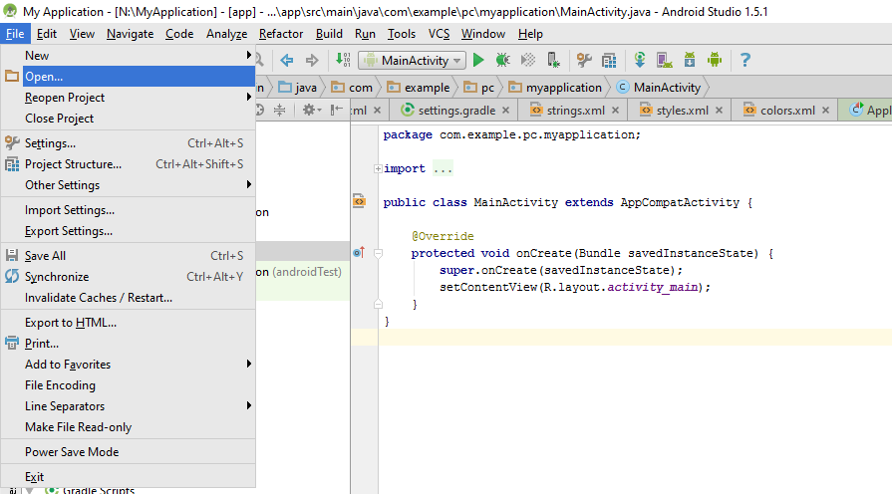
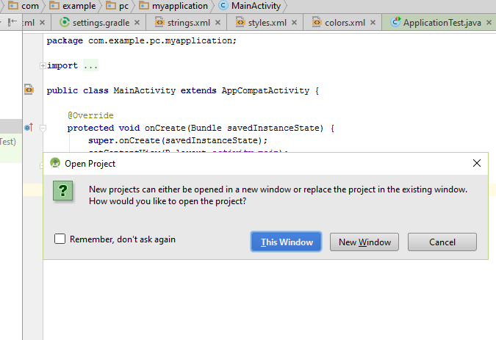
Import a project to the Android Studio

